Slide 1

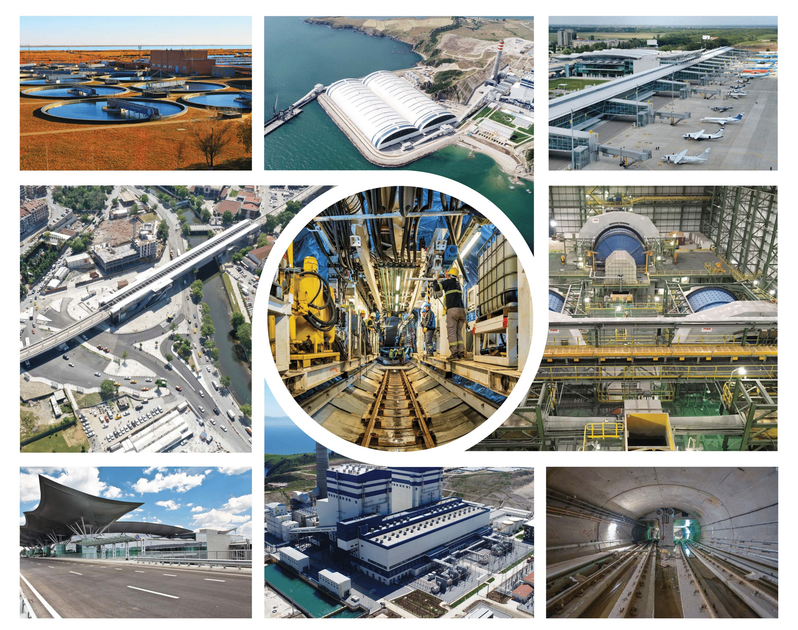
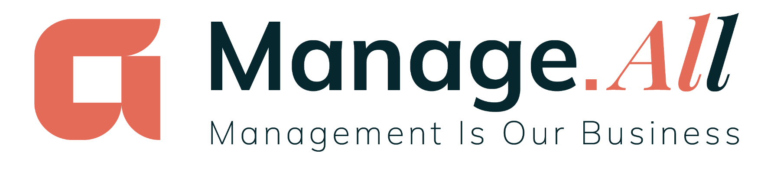
PROJECT MANAGEMENT AND TECHNICAL CONSULTANCY SERVICES

Slide 2
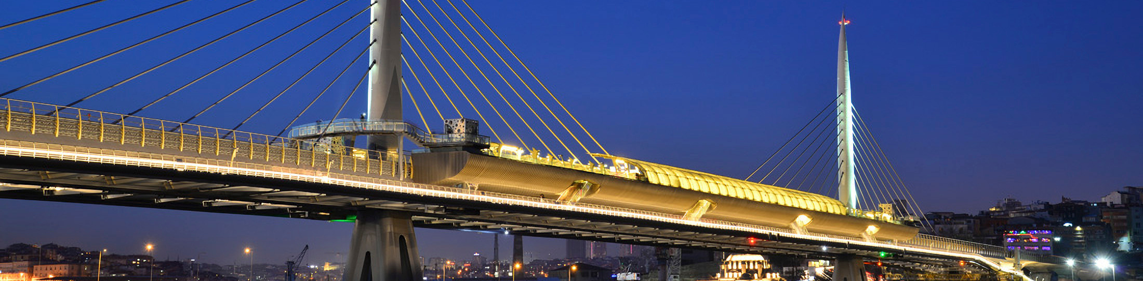
ABOUT ALARKO
Founded in 1954 by İshak Alaton and Dr. Üzeyir Garih as a collective company, ALARKO became a holding company in 1973 and ALARKO CONTRACTING GROUP was established in the same year to carry out contracting services.
ALARKO CONTRACTING GROUP, has become one of the most reliable and respected companies in the sector, both domestically and internationally, with more than 350 projects executed in 7 fields of activity across 12 countries on 3 continents.
With the mission of becoming an international contracting company that will be the first choice of its customers, employees, business partners and society in the restructuring of the globalized world, Alarko Contracting Group has a strong position both domestically and internationally with its respected and reliable identity.
With over 70 years of experience, we aim to present our customers and stakeholders our strong expertise, knowledge base, corporate culture and reliable identity built on solid foundations through our Manage.All brand in the form of Project Management and Technical Consultancy Services.
More Information

Slide 3
INTERNATIONAL CONTRACTING AND PROJECT MANAGEMENT EXPERIENCE ACROSS 3 CONTINENTS
MOROCCO
ALGERIA
GERMANY
ROMANIA
TÜRKİYE
CYPRUS
UKRAINE
JORDAN
KAZAKHSTAN
OZBEKISTAN
3
CONTINENTS
12
COUNTRY
7
ACTIVITY
FIELDS
  Transportation Projects
  Industrial Plants
  Refineries, Chemical and
  Petrochemical Plants
  Power Plants
  Oil, Gas and Pipelines
  Water & Wastewater
  Treatment Plants
TURKMENISTAN
IRAN
RUSSIA
  Housing and Building Projects

Slide 4

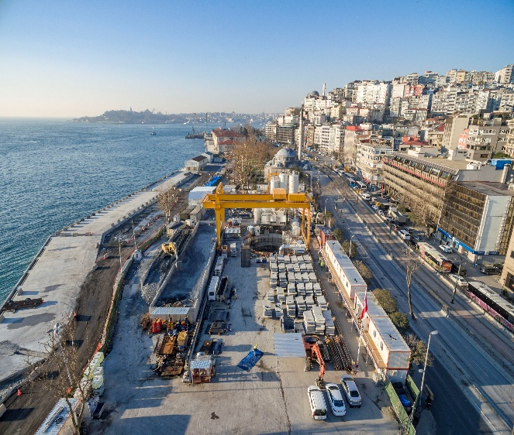
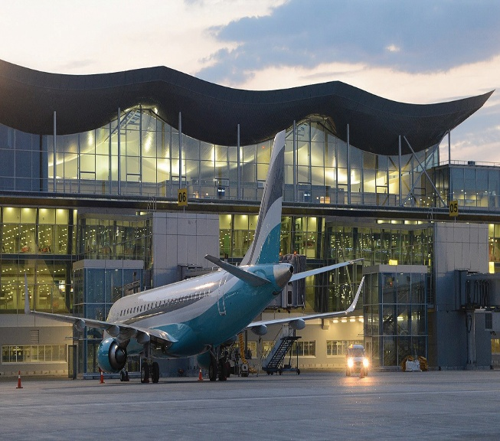
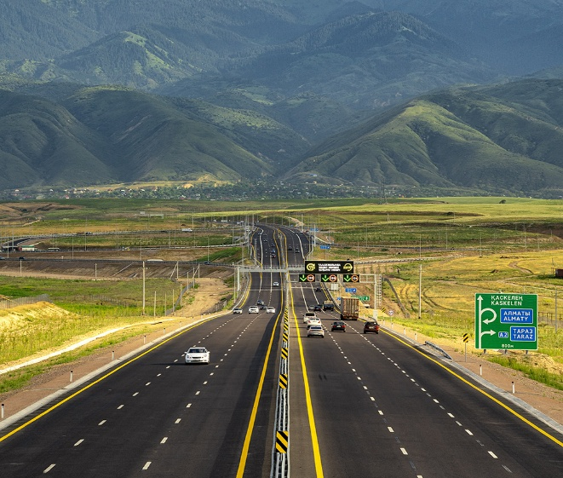
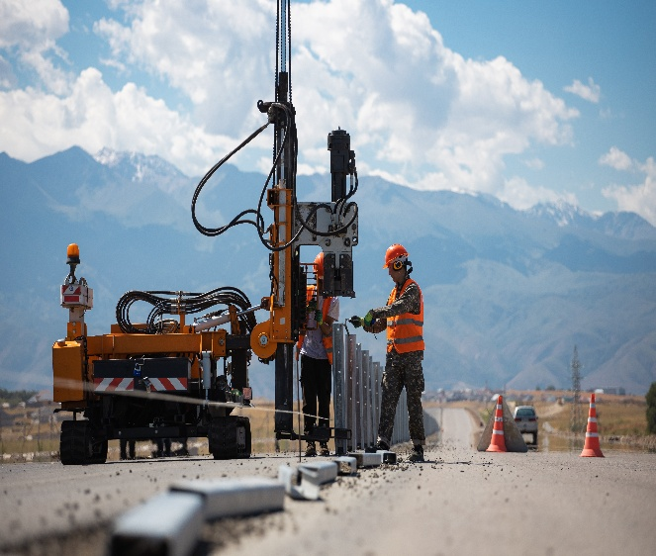
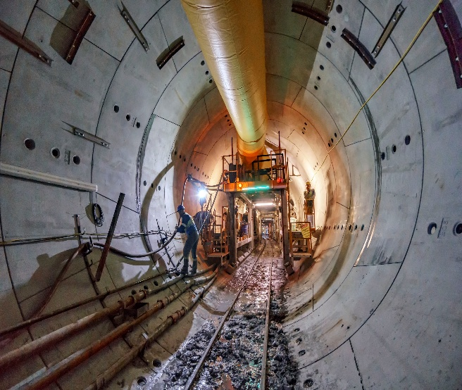
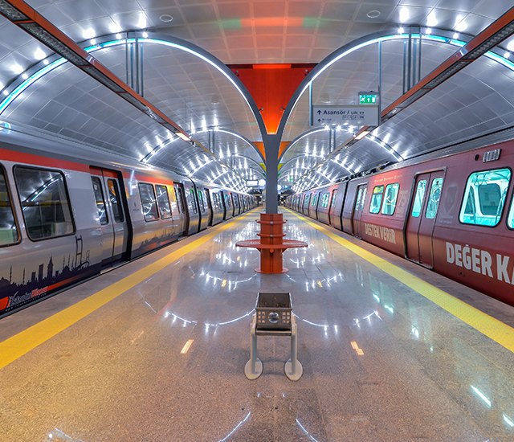
TRANSPORTATION PROJECTS
+40
+100 km
+900 km
+300.000 m²
+410 km
Transportation Projects
Metro Line
Highway
Airport Buildings
High-Speed Train Railway Line
Our Major Projects
  Almaty Ring Road Project (BAKAD – Kazakhstan)
  Henri Coanda M6 Metro Lot 1.1: 1 Mai-Tokyo (Romania)
  Bucharest Southern Ring Road Lot-1 and Lot-2 (Romania)
  Kabataş-Mecidiyeköy-Mahmutbey Metro (Türkiye)
  Ankara Metro Electromechanical Works (Türkiye)
  Hacıosman-Levent-Hisarüstü Metro (Türkiye)
  Taksim-Yenikapı Metro (Türkiye)
  Ankara-Istanbul High-Speed Rail Railway (Türkiye)
  Samsun Light Rail System Line (Türkiye)
  Boryspil International Airport (Ukraine)
  Astana International Airport (Kazakhstan)

Slide 5
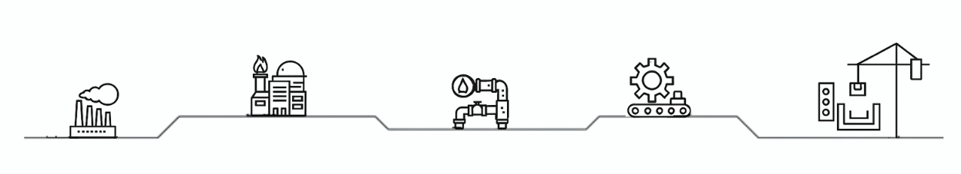
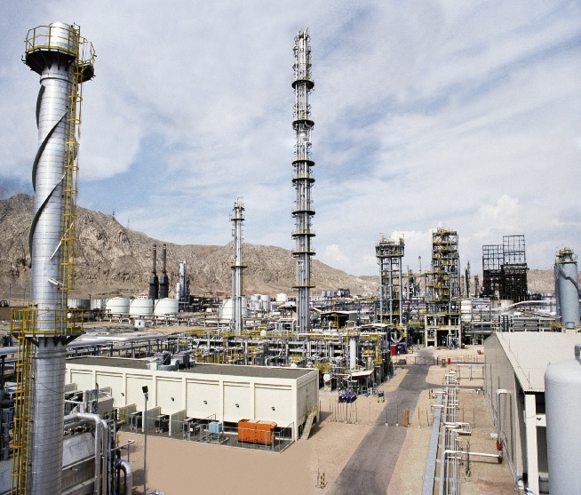
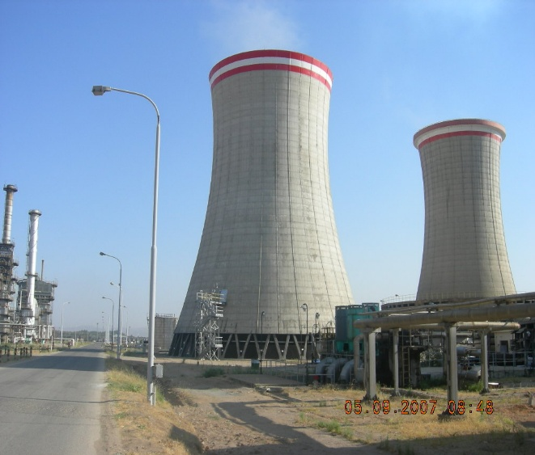
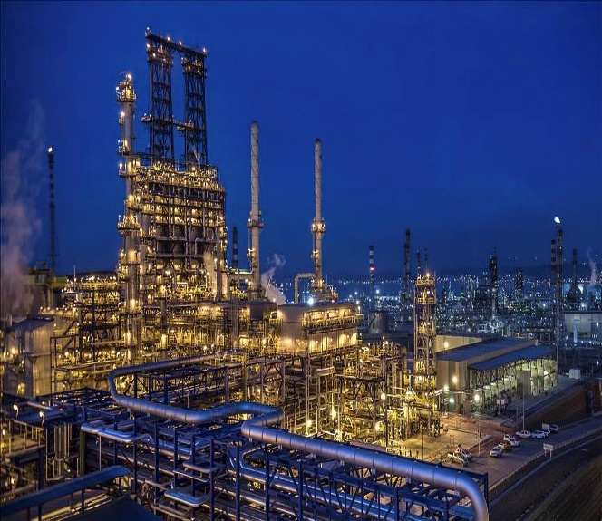
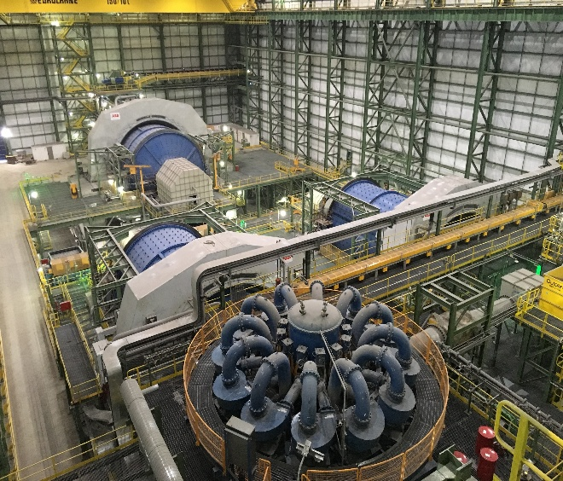
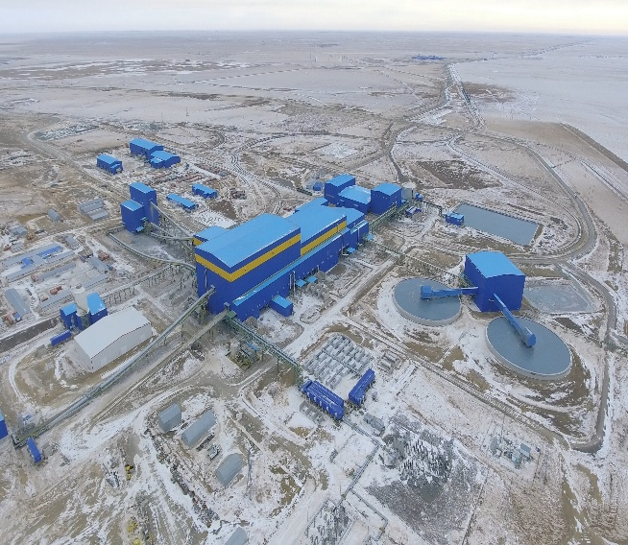
INDUSTRIAL, REFINERIES, CHEMICAL AND PETROCHEMICAL PLANTS
+160
+12
+40.000 ton
+26.000.000 ton
+10.000 ton
Industrial Project
Refineries, Chemical and Petrochemicals
Piping
Production
Steel Construction
Our Major Projects
  Bozshakol Copper Concentration Facility (Kazakhstan)
  Tüpraş Kırıkkale Refinery New Reformer and Diesel Desulfurization Unit (Türkiye)
  Tüpraş İzmit Refinery New Reformer and Diesel Desulfurization Unit (Türkiye)
  Turkmenbashi Polypropylene Factory (Turkmenistan)
  VCM & PVC Factory Construction – Aliağa Petrochemical Complex (Türkiye)
  Hyundai Automobile Factory (Türkiye)
  Philip Morris Cigarette Factory (Kazakhstan)
  Goznak Paper Factory (Russia)

Slide 6

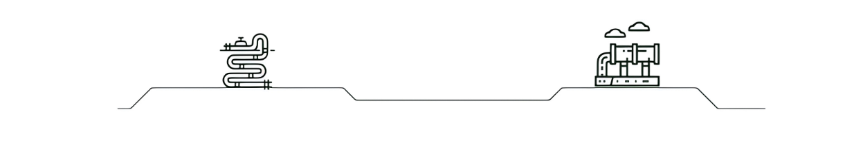
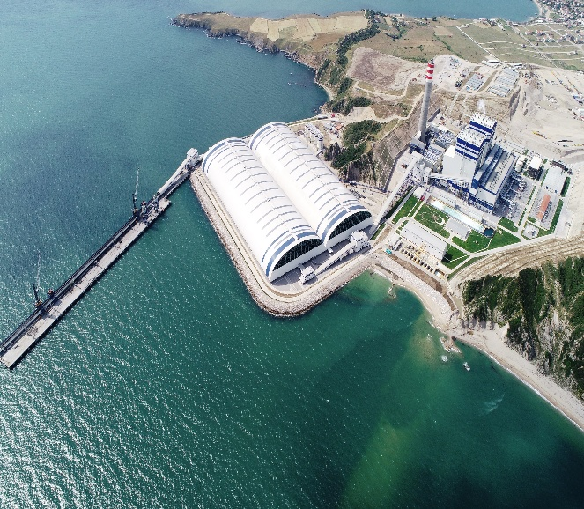
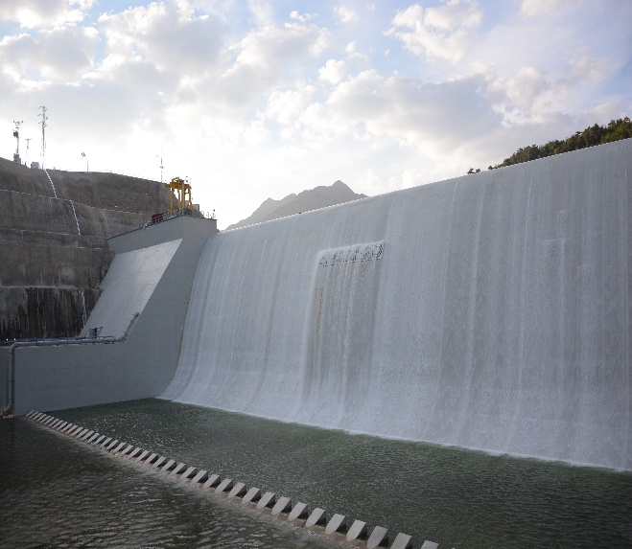
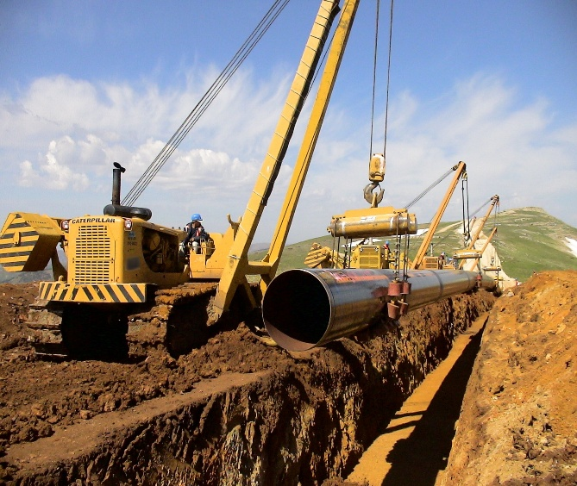
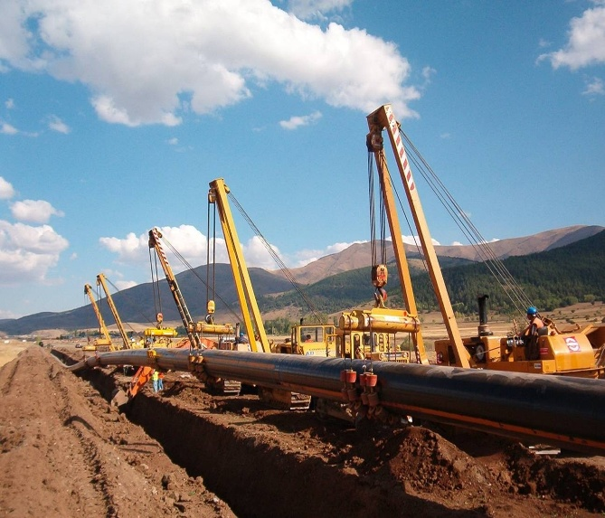
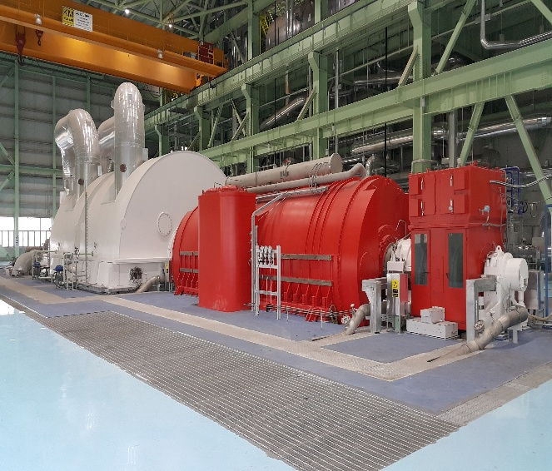
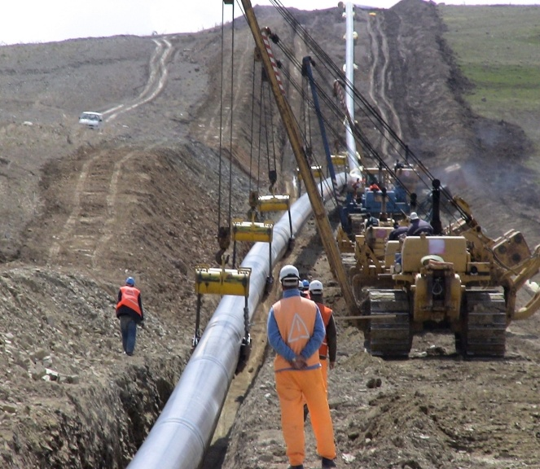
POWER PLANTS
OIL, GAS AND PIPELINES
+20
+1500 MW
+5
+800 km
Power Plants
Energy Production
Oil, Gas and Pipeline Projects
Pipeline
Our Major Projects
Our Major Projects
  Karabiga 1320 MW Ultra Supercritical Coal-Fired Power Plant (Türkiye)
  Karakuz Dam and Hydroelectric Power Plant (HES) Project (Türkiye)
  Kırklareli 81.99 MW Combined Cycle Natural Gas Power Plant (Türkiye)
  Bakü – Tiflis – Ceyhan Crude Oil Pipeline Lot-B (Türkiye)
  Erzurum İmranlı Natural Gas Pipeline (Türkiye)
  Melen Potable Water Pipeline Project (Türkiye)

Slide 7


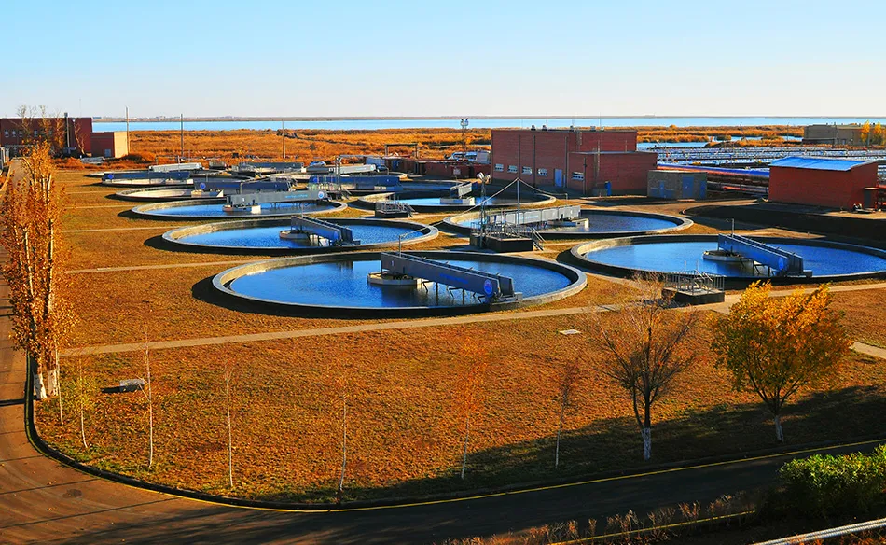
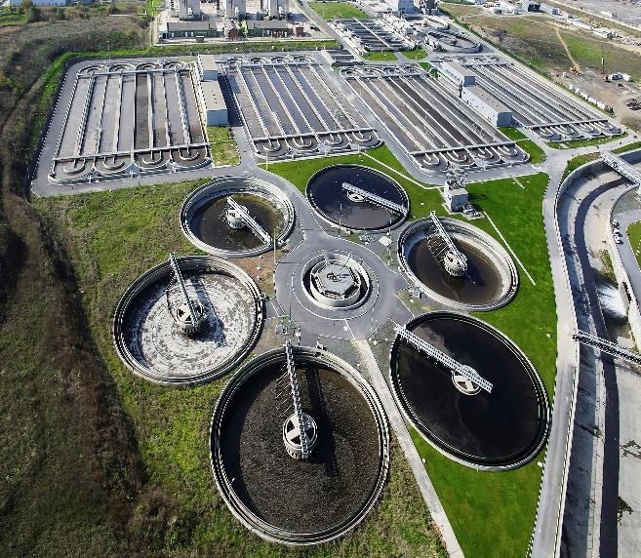
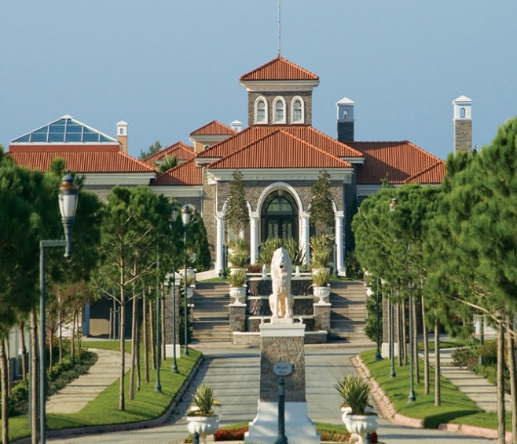
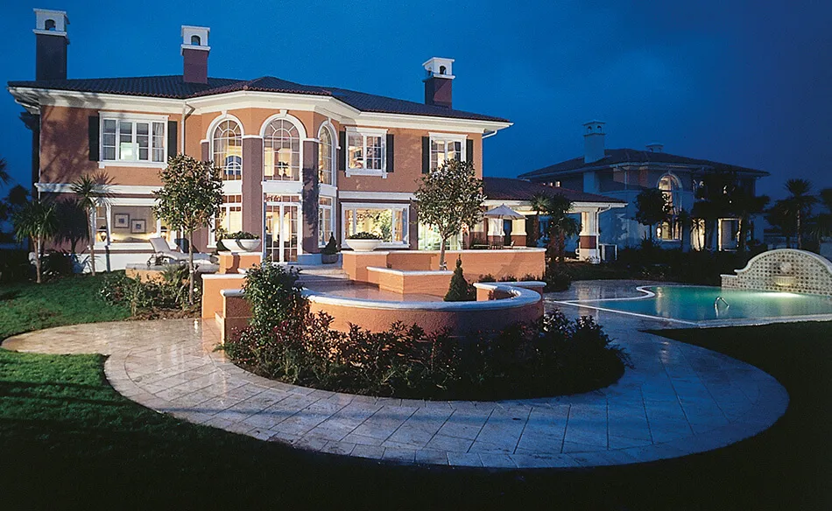
WATER & WASTEWATER TREATMENT PLANTS
HOUSING AND BUILDING PROJECTS
+50
+20
+1.400.000 m²
+250 km
+10
Water Project
Housing Project
Indoor Area
Water Distribution
Treatment Plant
Our Major Projects
Our Major Projects
  Taldykol Sewer Pond Liquidation with Recultivation Project (Kazakhstan)
  Izmit Bay Waste Water Treatment Plant (Turkey)
  Astana Water Distribution And Sewerage Project (Kazakhstan)
  Sea Outfall of Üsküdar-Baltalimanı (Turkey)
  Tuzla Biological Waste Water Treatment Plant (Turkey)
  Baltalimanı Pre-Treatment Plant (Turkey)
  Renovation of Presidency Tarabya Huber Mansion (Turkey)
  Suleyman Demirel University Hospital (Turkey)
  Nevsky 25 Bussiness Central (Russia)
  Tverskaya Shopping Central (Russia)
  Moscow Embassy Building (Russia)
  Oncology Child Hospital (Russia )
  Dovestrasse Residences (Germany)
  Alkent Lake Villas (Turkey)

Slide 8
Why Manage.All
Experience and Technical Competence
Trust and Respectability
  Experience and strategic approach
  Time, quality and cost-focused project planning and project management
  Multidisciplinary project management including civil, electrical, mechanical and signalization systems along with construction works
  Collaboration with expert individuals and companies according to project requirements
  Budget at completion with Project Information Management system
  Developing effective strategies to prevent deviations from targets
  Mitigating legal risks through compliance with local and international regulations
  Strategic planning and management competence
  Organizational strength and resource management
  Enhancing global acceptability and competitiveness through compliance with standards and robust operational capabilities
  Working as a team at all levels with mutual trust and respect and prioritizing team success
  Establishing long-term collaborations
  Increasing sustainability and functionality by offering solutions that provide long-term value rather than short-term success
  Establishing a strong reputation built on reliability
Institutional Strength
  Transition from individual to corporate management
  Prioritization of transparency, accountability and discipline
  Effective collaboration and process efficiency among all stakeholders
  Strong emphasis on expertise, talent, quality and reliability
  Recognizing occupational health and safety as a corporate value and a fundamental human right
  Sustainable quality standard and management
  Effective training and awareness programs

Slide 9

OUR SERVICES OF PROJECT MANAGEMENT AND
CONSULTANCY
  PRE-CONSTRUCTION MANAGEMENT
  Pre-Construction Assistance Services
  Engineering Management
  PROJECT MANAGEMENT
  Engineering Management
  Planning and Cost Control Management
  Procurement, Subcontractor Tender and Logistics Management
  Contract and Commercial Management
  Reporting and Document Control Management
  CONSTRUCTION MANAGEMENT
  Construction Supervision
  Project Oversight

Slide 10
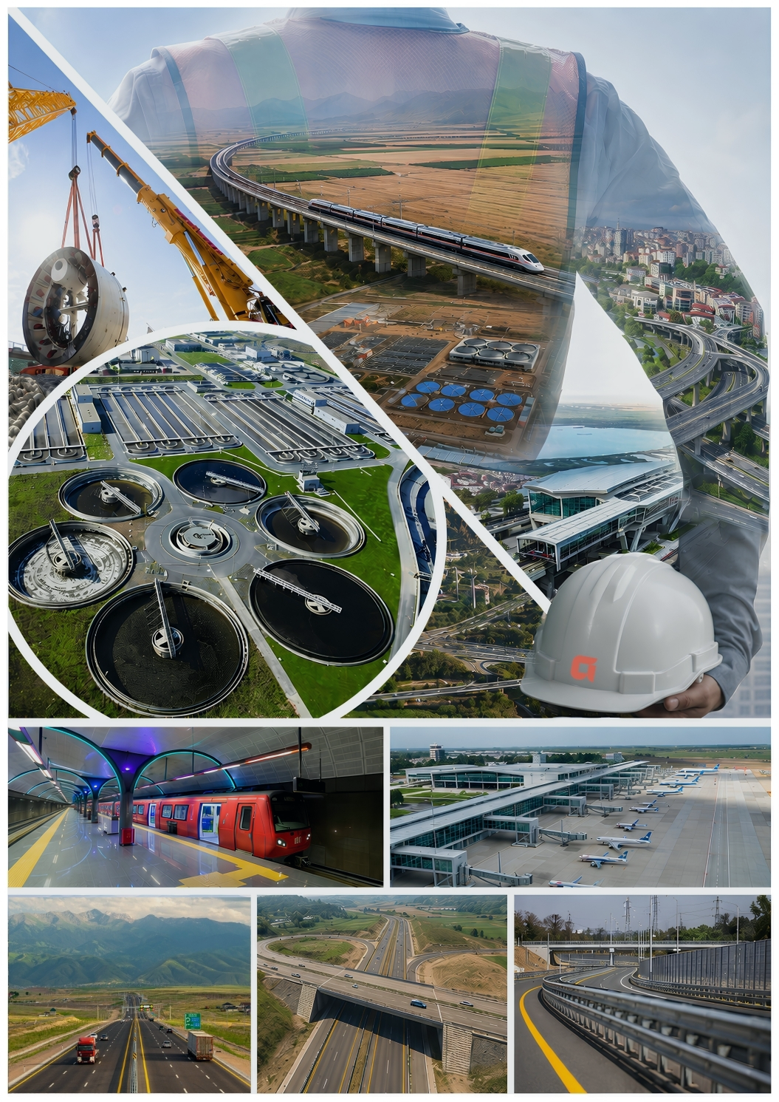
PRE-CONSTRUCTION MANAGEMENT

Slide 11

PRE-CONSTRUCTION ASSISTANCE SERVICES
Pre-Construction Assistance Services
  Administrative and Technical Review Of The Contract
  Identification of Risk & Opportunity Strategies
  Prioritization of Requirements of Financing Institutions
  and Preparation of Relevant Document
  Contract Negotiation and Signing
  Contract Management Assistance
  Assistance with Client / Employer Presentations
  Supporting Processes With Financing Institutions
  Planning of Material Procurement and Equipment
  Preparing the Documents to be Submitted to the Employer
  - Work Schedule and Construction Methodology
  - Project Management Plan
  - Quality, OHS, Social and Environmental Management Plans
  - Document Management Plan
Why Manage.All
  Accurate Definition of Needs and Requirements
  Proper Planning of Resources and Timelines for Project Success
  Effective Analysis of Risks & Opportunities
  Effective and Proper Management of Employer/Client Relationships

Slide 12

ENGINEERING MANAGEMENT
Engineering Management Services
  Design Planning and Management Plan
  Selection of Design Team
  Design Review Support and Value Engineering
  Preparation of Tender Packages, Technical Specifications and Bills of Quantities
  Preparation of Detailed Design-Based Budget and Schedule.
  Comprehensive Interdisciplinary Coordination
  Determination of Critical Procurement Packages
  for Pre-ordering
  Planning of Mobilization and Installation
  Assistance With Obtaining Construction Permits
Why Manage.All
  Engineering Experience and Strategic Approach
  Accurate Tendering and Contractor Selection
  Cost-Benefit Analyses with Alternative Scenarios
  Preventing Time Delays and Budget Overruns
  Standard-Compliant and Regular Reporting
  Compliance with Quality Standards and High Reliability
  Increasing Functionality with Long-Term Solutions

Slide 13
PROJECT MANAGEMENT

Slide 14
ENGINEERING MANAGEMENT
Engineering Management Services
  Design Planning
  Management of Design Team
  Preparation of Design Work Schedule
  Design Review Support and Value Engineering
  Change Order Management
  Site and Design Team Coordination
  Review of Shop Drawings and Material Submittals In Accordance With Technical Specifications
  Managing RFI Process With Engineering Team
  Management of Technical Variation
  Assistance with Preparation of Operation Manuals and Acceptance Processes
Why Manage.All
  Effective Coordination with Design Teams
  Standard-Compliant and Regular Reporting
  Transparent and Monitorable Processes
  Adherence to the Project Schedule
  Effective and Efficient Use of Resources
  Minimizing Legal and Technical Risks
  Compliance with Quality Standards and High Reliability
  Seamless Handover and Operation Processes

Slide 15

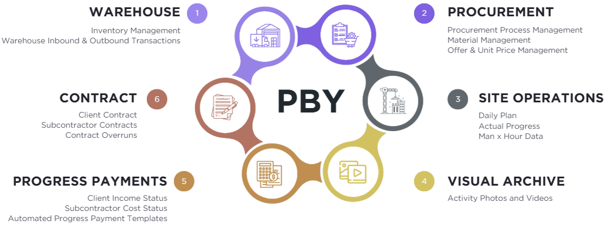
PLANNING AND COST CONTROL MANAGEMENT
Planning and Cost Control Management Services
  Preparation of Budget and Work Schedule
  Tracking of Performance In Accordance With Budget and Work Schedule
  Preparation of Project Monthly Activity Report
  Cost Control and Monitoring
ERP Software - PBY (Project Information Management)
Why Manage.All
  Earned Value Analysis
  Variance and Delay Analyses
  Income and Expense Comparisons
  Flexible Reporting Module
  Budget – Actual Comparison
  Compliant with Commitment and
  Control Processes
  In-house Project Management Software
  Real-Time KPI Monitoring
  Planning In Accordance With Global Standards
  Effective Cost & Physical Progress Control
  Customized Solutions
  Integrated Project Management
  Budget Discipline and Resource Efficiency
  Transparency and Traceability

Slide 16

PROCUREMENT, SUBCONTRACTOR TENDER AND
LOGISTICS MANAGEMENT
  Strategic Procurement Planning
  Preparation of Procedures
  Establishment of Organization
  Comprehensive Market Research Based on the
  Project’s Requirements
  Preparation of Tender Documents
  Tender Organization for Subcontractors
  Technical and Financial Evaluation Reports of Tender
  Contract Management of Suppliers and Subcontractors
  Evaluations of Supplier and Subcontractor Performance
  Management of Foreign Trade and Transportation Services
Why Manage.All
  Determination of Qualified Subcontractor and Supplier
  Optimizing Time and Resources through Professional Tender Management
  Continuous Supply Process
  Eliminating Uncertainties
  Fast and High-Quality Project Delivery
  Effective Tender Processes to Minimize Legal Risks
  Strong Communication with Subcontractors for Sustainable Project Success

Slide 17
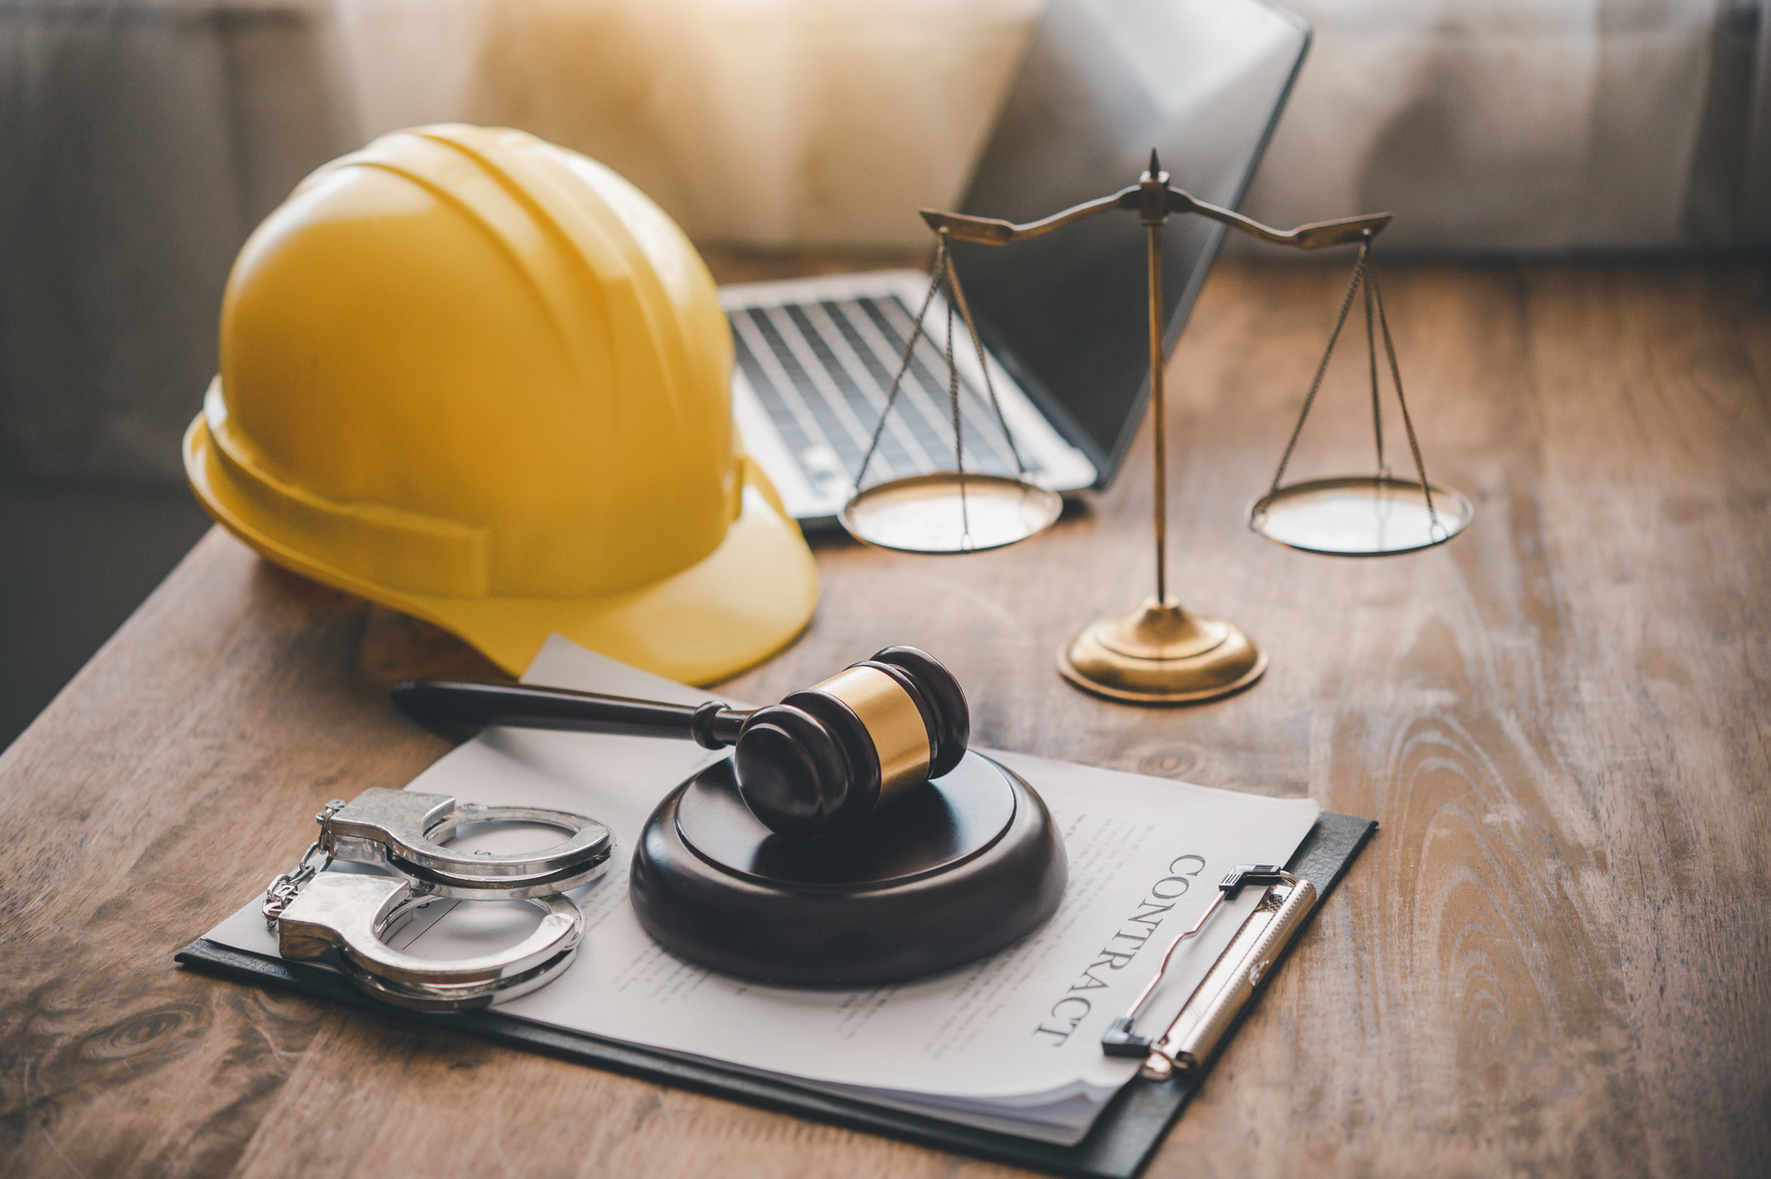
CONTRACT AND COMMERCIAL MANAGEMENT
  Contract Administration
  Contract Management
  Commercial Risk Assessment
  Claims Coordination (Coordination Between Insurers, Brokers and Internal Stakeholders)
  Claims Support Services
  Dispute Coordination and Support Services
  Dispute Financial Management, Budget Control and Contractual Reporting
  ESG, Sustainability and Corporate Compliance Management
  Contractual Awareness and Training for Site Teams
Why Manage.All
  Proactive Risk Mitigation
  Streamlined Claims Resolution
  Robust Dispute Management
  Optimized Project Lifecycle Management
  Regulatory & Corporate Alignment

Slide 18

REPORTING AND DOCUMENT MANAGEMENT
Reporting And Document Management Services
  Ensuring Quality Assurance
  Document Control & Records Management
  OHS, Environmental & Social
  Implementation Management
  Environmental & Social Impact Assessment
  Project Closure and Knowledge Transfer
  Monitoring and Evaluation Reporting Within the Contract
    - Inspection Reports
    - Monthly Progress Reports
    - Monthly / Annual E&S Monitoring Reports
    - Monthly / Annual OHS Monitoring Reports
    - Financial Reports and Monthly Statements
    - Monthly Work Plan and Budget
    - Procurement Plan
Why Manage.All
  Integrated Project and Contract Management
  Quality and Standards Compliance Assurance
  Process-Oriented Approach
  Transparency and Traceability
  Complete and Standard Document Delivery
  Document Revision Management

Slide 19
CONSTRUCTION MANAGEMENT

Slide 20

CONSTRUCTION SUPERVISION
Construction Supervision Services
  Design Review and Approval
  Commencement of Work On Site
  Oversee All Civil, Mechanical, Electrification, Signaling
  and Telecommunication Works
  Programming and Monitoring Progress
  Contract and Financial Management
  Site Management
  Ensure Systems Testing and Commissioning
  Completion and Defects Notification Period
  Environmental and Social Management
    - ESMP & ESIA and All Sub-Management Plans Review
    - Monitoring Day-to-Day Operations For Strict Compliance With the Plans
    - Stakeholder, Labor, Biodiversity and Cultural Heritage Management
    - Monitoring Implementation of the Resettlement Plan
  Health and Safety Management
    - Verify Preparation and Execution OHS Plan
    - Monitoring Daily Site Activities On Behalf of The Employer
    - Ensuring The Contractor Provides and Maintains Required Safety Measures (lighting, fences, signs etc.)
  Quality Assurance and Control Management
    - Quality Management Plan Review and Approval
    - Audit and Verify The Effective Implementation of The QA/QC System On-Site
    - Establishing Procedures for Inspecting and Measuring Works
    - Site And Factory Inspections
    - Defect & Non-Conformance (NCR) Management
    - Document Management
Why Manage.All
  Timely completion and adherence to budget
  Compliance With the Client Requirements
  Safeguarding Construction Quality
  Overseeing Site Safety Throughout The Works
  Facilitating The Successful Handover of The
  Completed Works

Slide 21

PROJECT OVERSIGHT
Project Oversight Services
  Project Management and Organization
  Contractor Audit (Execution and Operational Processes)
  Progress and KPI Monitoring
  Review of Goods and Materials Procurement
  Review of Testing and Commissioning
  Independent Environmental, Social and OHS Monitoring & Audits
  Review of Project’s Progress Adequacy of Delivery Arrangements
  Risk Management
Why Manage.All
  Effective Communication and Reporting Between Stakeholders
  Rapid Detection and Effective Solutions
  Comprehensive Project Management with a Focus on Safety and Efficiency
  Transparent Monitoring and Inspection

Slide 22

Tel: (0212) 953 57 00
E-mail: info@manageall.com.tr
Web: https://www.manageall.com.tr
LinkedIn: Manage.All
THANK YOU

